Slide 1
Practice on configuring & creating WIFI & webservers using ESP8266
1: WIFI
2:webserver with compressed string (basic)
3: webserver with websocket
from server(ESP8266) → Client (Webbrowser)
4: webserver with websocket
(bidirectional communication)

Slide 2
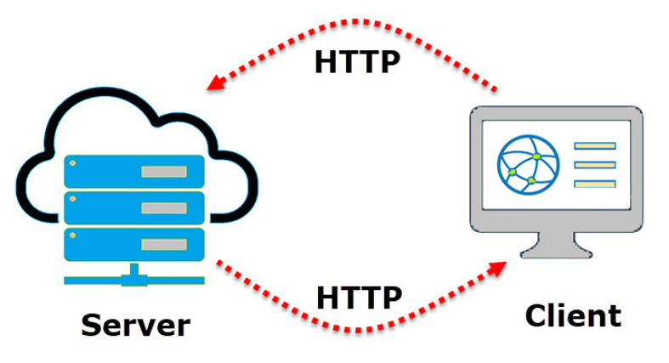
ESP8266 - webserver
Notes:
this type of communication is called as Client – Server Model.
The communication between Client and Server is implemented using a special protocol called HTTP or Hyper Text Transfer Protocol.
In this type of communication, the Web Client makes a request for information from the server using HTTP.
The Web Server, which is always waiting (listening) for a request, responds to the client’s request with appropriate web page.
If the requested page is not found, then the server responds with HTTP 404 Error.

Slide 3
By combining official documentation, examples, and hands-on experimentation, you'll gain a solid understanding of creating web servers with the ESP8266 using the Arduino framework.

Slide 4
WIFI end WebServer Libraries
The ESPAsyncWebServer library
GitHub - me-no-dev/ESPAsyncWebServer: Async Web Server for ESP8266 and ESP32
Rename the library folder to ESPAsyncWebServer
The ESPAsyncTCP library
GitHub - me-no-dev/ESPAsyncTCP: Async TCP Library for ESP8266
The WiFi.h library
Notes:
Use the github pages for general info on how to use the libraries, syntax, methods, functions etc..

Slide 5
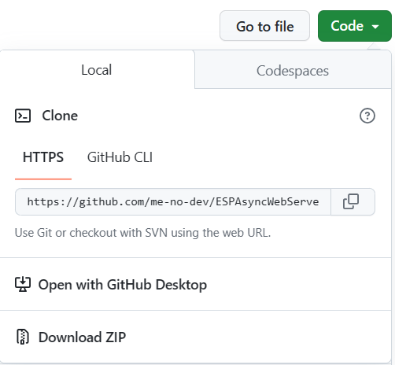

Method for incorporating the ESPAsyncWebServer.h & ESPAsyncTCP.h libraries
- In code ‘dropdown’ click download ZIP
Place in your library folder
Notes:
the

Slide 6

Establish WIFI connection using the ESP8266WiFi.h library

Slide 7


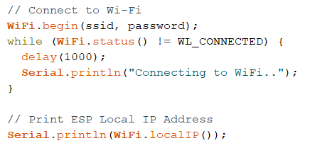
Connect to to wifi (IP address via DHCP)

Slide 8
Summarize utilizing wifi
What have we learned?
Notes:
Basic use of ESPWiFi.h library
Declaring global variables for SSID & password
DHCP IP
Basic use of Serial communication
How the setup() works

Slide 9

Basic webserver setup with compressed html strings

Slide 10
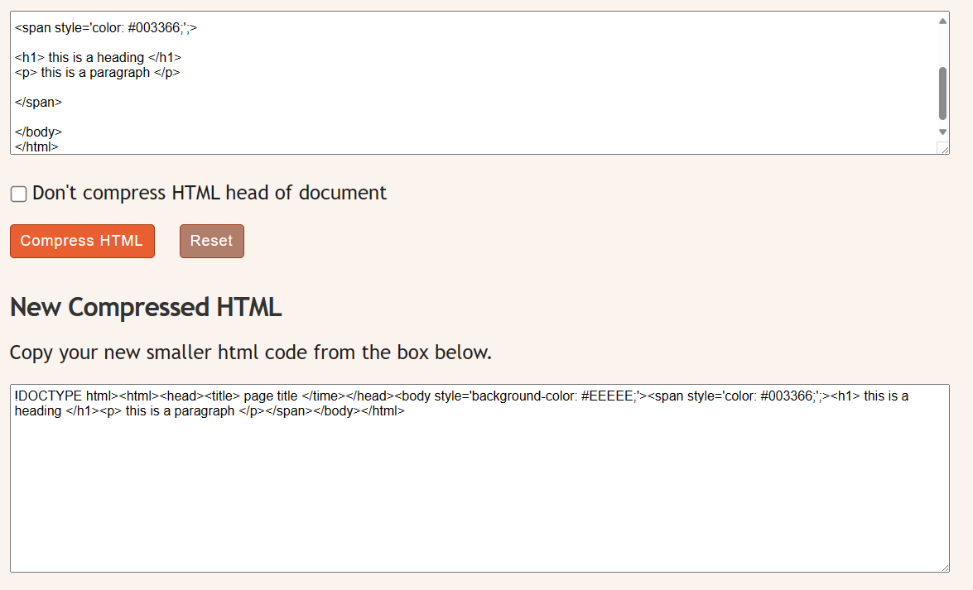
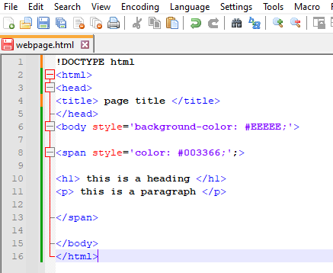
HTML editor ( notepad, sublime text, word…) - and compressing it
Simply copy/paste from editor into the compressor and copy that into that variable in the arduino IDE.
Notes:
When compressing html for the Arduino string it is important not to use “” but ‘’ instead, because the Arduino IDE will think that the string ends with “”. ( you could use / before each ”, but that would be a nightmare debugging)
Website for compressing html files into a single string : Compress HTML (textfixer.com)

Slide 11



1 webserver: compressed html string
Libraries:
Instansiations:
Variable declarations:
Setup() {
Notes:
Include libraries
Istantiate AsyncWebServer object, and refer to port 80 (port 80 is the default port for HTTP)
Initalise server and sets up a route handler for HTTP reqeusts to the root ”/” path
This is a C++ lambda function with a parameter of type AsyncWebServerRequest -This parameter represents the incoming HTTP request, and you can use it to gather information about the request or perform additional actions.
Inside the lambda function, request->send() is used to send an HTTP response:
200: The HTTP status code indicating a successful response
"text/html": The content type of the response. In this case, it's HTML
webpage: The actual content or HTML code that will be sent as the response
Declare “webpage” variable (string) for holding the HTML string ( see how next slide)
Summary:
This code sets up a route handler for the root path ("/") that responds to any HTTP request (GET, POST, etc.) with a 200 status code, "text/html" content type, and the HTML content specified by the webpage variable. The webpage variable should contain the actual HTML content you want to send as a response.

Slide 12
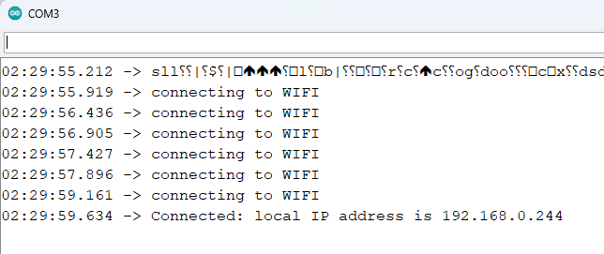
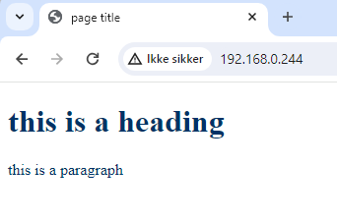
Result:

Slide 13

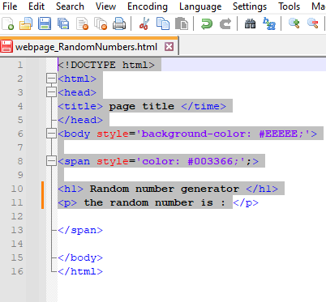
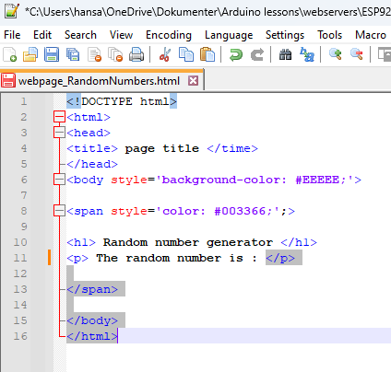
- Random number generator
Notes:
Lets create a random number genrator function we can pretend that it is a sensor..
1: Create new string variables.
2: Go to editor and rewrite the h1 and the p attributes
3:split up the code: take the highlighted section compress it and put in variable webpage_1
4: highlight the last section compress it and put in variable webpage_2
5: add a string containing the random function with parameters between 0-100 and add the 2 variables together in the webpage variable.

Slide 14
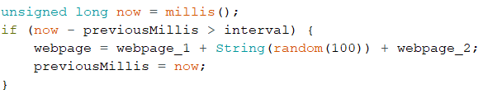
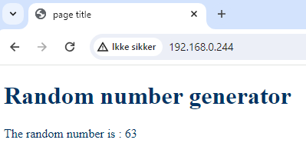
Time interval for random number generator
This way we get a new number (0-100) with every refresh of the webpage.
Lets automate that so we dont have to refresh the whole page everytime.

Slide 15

Webserver with websockets from server(ESP8266) → Client (Web browser)
Notes:
A WebSocket is a persistent connection between a client and a server that allows bidirectional communication between both parties using a TCP connection.

Slide 16

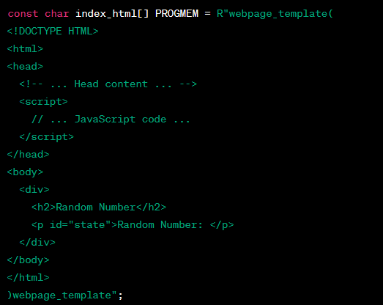
Communication from ESP8266 to client (web browser) - instead of a string we will now introduce a new concept: raw string literal in C++, which is often used for embedding large chunks of text (such as HTML or JSON) directly in the code.
Notes:
const char: Declares a constant character array
index_html: The name of the array, which holds the HTML content.
PROGMEM: A directive that tells the compiler to store the data in the program memory (flash) instead of the RAM. This is crucial for devices with limited RAM, such as the ESP8266.
R"rawliteral(: The start of a raw string literal. The rawliteral part is a user-defined identifier, and it can be any valid C++ identifier. It is used to mark the beginning of a raw string and must be matched at the end
A raw string literal allows you to include multiline strings more conveniently without escaping special characters.
The ( ) used after R"rawliteral marks the beginning and end of the raw string literal, and the identifier inside (rawliteral in this case) acts as a delimiter. The literal is terminated when the same identifier is encountered again:
So, the entire HTML content is included in the index_html array as a single, raw string literal. It makes it easier to include HTML content without dealing with escape characters or concatenating strings. The PROGMEM directive ensures that this content is stored in flash memory rather than RAM, which is essential for devices with limited RAM like the ESP8266.

Slide 17
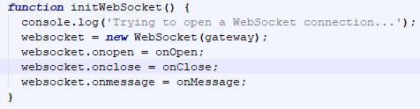




HTML/JavaScript
Notes:
HTML Head Section:
The <head> section typically contains meta-information about the HTML document, such as the title and viewport settings.
In this case, it includes a <title> element with the title "ESP Web Server" and a <meta> tag for setting the viewport width.
JavaScript Section:
The JavaScript code is embedded within the <script> tags.
It declares two variables: gateway and websocket.
gateway is a WebSocket URL constructed using the current window's hostname. It assumes a WebSocket path of "/ws".
An event listener is added to the window's "load" event, triggering the onLoad function when the page is loaded.
The initWebSocket function attempts to open a WebSocket connection using the specified gateway. It sets up event handlers for the WebSocket (onopen, onclose, and onmessage).
onOpen and onClose functions log messages to the console when the WebSocket connection is opened or closed, respectively.
The onMessage function updates the content of an HTML element with the id "state" with the received data from the WebSocket.
The onLoad function is called when the page is loaded, initiating the WebSocket connection.
HTML Body Section:
The <body> section contains a <div> element with an <h2> heading ("Random Number") and a <p> paragraph element with the id "state" (initially displaying "Random Number: ").
In summary, this code sets up a simple web page that establishes a WebSocket connection to a server. When the connection is open, it logs a message, and when a message is received, it updates the content of the HTML element with the id "state" with the received data. If the connection is closed, it attempts to reconnect after a delay of 2000 milliseconds (2 seconds).

Slide 18

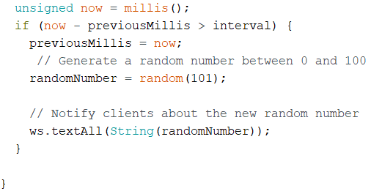

configure the ESP8266 (variables, setup & loop)
Notes:
Variables & objects:
randomNumber: Holds the generated random number.
server: An instance of the AsyncWebServer class to handle HTTP requests.
ws: An instance of AsyncWebSocket class for WebSocket functionality.
const char webpage: This is the HTML code that will be served to clients. It includes JavaScript for WebSocket communication.
Setup Function:
Initializes serial communication for debugging.
Connects to Wi-Fi.
Sets up an HTTP route to serve the HTML page.
Registers an event handler for WebSocket events.
Starts the web server.
Loop Function:
Uses ws.cleanupClients() to manage WebSocket client connections.
The main loop generates a random number every second.
Sends the random number to all connected WebSocket clients.

Slide 19

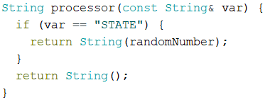
ESP8266 - functions
Notes:
WebSocket Event Handler:
This function is a placeholder for handling WebSocket events like client connections, disconnections, and data reception. You can extend this function based on your needs.
Processor Function:
This function is used by the web server to replace placeholders in the HTML file. It replaces %STATE% with the current random number.

Slide 20
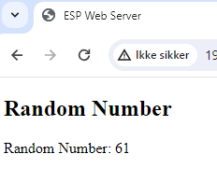
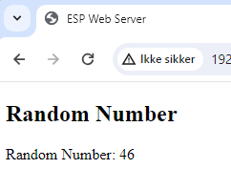
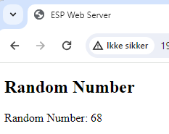
Result: automatic updates of the random number every second.

Slide 21

Webserver with websockets - Bidirectional communication
Notes:
Random number generator is, as we practised in the previous example, our communication from the server (ESP8266) to the client (web browser)
In this section we will create a button that toggles the state of an LED (this could be the builtin LED, GPIO 2 or any other)

Slide 22
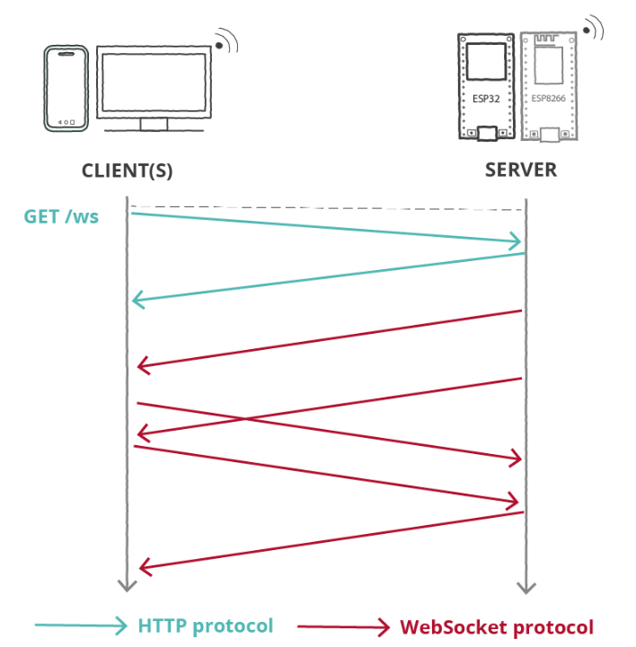
We will be building on our previous example so i will only be going through the changes in the code.

Slide 23
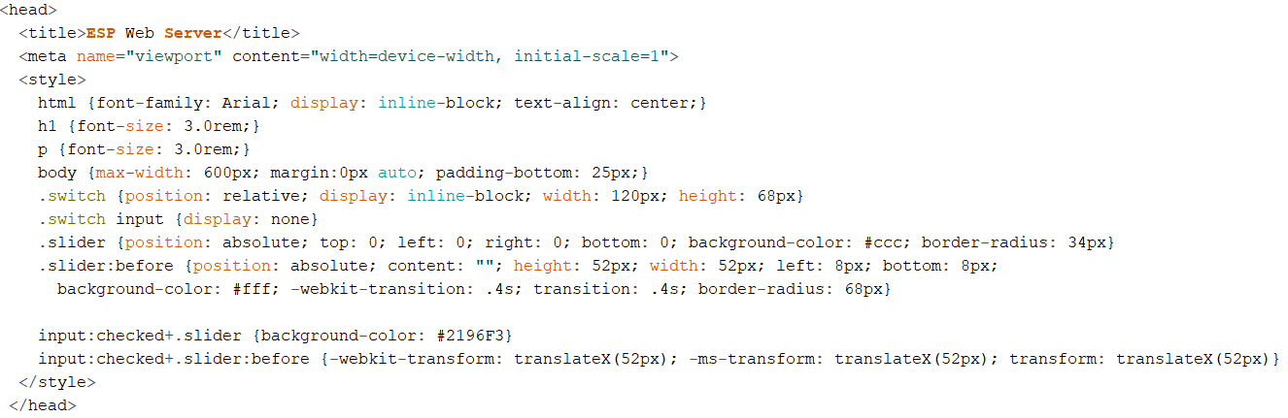
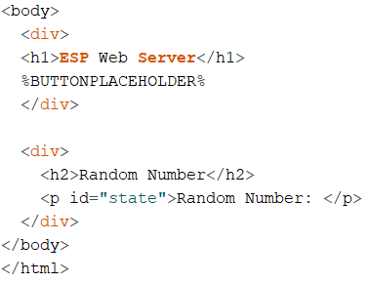
Changes in HTML/CSS section
Notes:
HTML Structure:
The HTML structure includes a DOCTYPE declaration, an opening <html> tag, a <head> section for metadata, and a <title> tag for the web page title.
Viewport Configuration:
This meta tag configures the viewport settings for better responsiveness on different devices.
Styles:
The style section contains CSS rules that define the appearance of HTML elements.
html, h1, p, body: Define general styles for HTML, headings, paragraphs, and the body.
.switch: Styles for the switch container.
.switch input: Hides the actual checkbox input inside the switch container.
.slider: Styles for the slider within the switch.
.slider:before: Styles for the slider knob.
input:checked+.slider: Styles for the slider when the checkbox is checked.
input:checked+.slider:before: Styles for the slider knob when the checkbox is checked.
Body Section:
The <body> section contains two main <div> elements.
First <div>:
Displays the title "ESP Web Server" as an <h1> heading.
The %BUTTONPLACEHOLDER% placeholder will be replaced dynamically by the ESP8266 with the HTML code for the switch/button.
Second <div>:
Displays a heading "Random Number" as an <h2> heading.
Contains a paragraph (<p>) element with the id "state" where the random number will be dynamically inserted.
%BUTTONPLACEHOLDER% → This placeholder is used to dynamically insert the HTML code for the switch/button generated by the ESP8266's processor function.

Slide 24

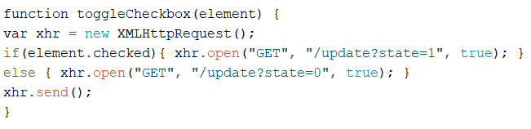
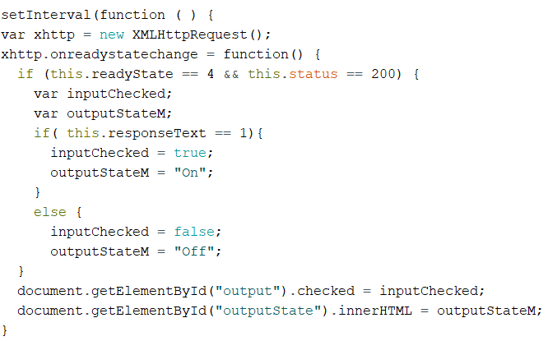

Changes in JavaScript section
Notes:
WebSocket Event Handling
The onEvent function is a placeholder for handling WebSocket events.
Depending on your needs, you can extend this function to perform specific actions when WebSocket events occur
WebSocket Toggle Checkbox Function
The toggleCheckbox JavaScript function is called when the toggle switch in the web page is interacted with.
It sends a GET request to "/update" with the state of the toggle switch (state=1 for ON, state=0 for OFF).
setInterval Function:
setInterval Function:
setInterval is a JavaScript function that repeatedly calls a provided function (in this case, an anonymous function) at a specified time interval.
XMLHttpRequest:
XMLHttpRequest is used to make HTTP requests from the browser.
Request Callback Function:
The onreadystatechange event is triggered every time the readyState of the XMLHttpRequest changes.
readyState 4 means the operation is complete, and status 200 means a successful HTTP response.
Response Processing:
If the responseText is equal to 1, it sets inputChecked to true and outputStateM to "On"; otherwise, it sets them to false and "Off" respectively.
Update HTML Elements:
document.getElementById("output").checked is set to inputChecked. This updates the state of a checkbox element with the id "output" based on the server response.
document.getElementById("outputState").innerHTML is set to outputStateM. This updates the inner HTML content of an element with the id "outputState" to display the current state.
HTTP Request:
xhttp.open("GET", "/state", true); opens a GET request to the "/state" endpoint on the server.
Request Sending:
xhttp.send(); sends the request to the server.
Interval Duration:
The entire process repeats every 1000 milliseconds (1 second), as specified by the last parameter in setInterval (1000).
This code ensures that the web page is updated every second with the current state of the output obtained from the server. The server's "/state" endpoint likely returns the current state of the output pin.

Slide 25
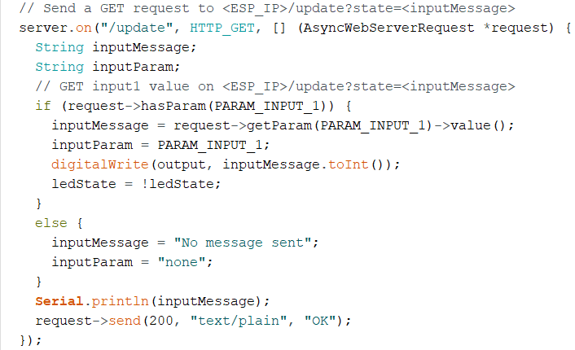







Changes in arduino IDE – Variables & Setup()
Notes:
Variables:
PARAM_INPUT_1: A parameter name used in HTTP GET requests to control the state of the output pin.
output and buttonPin: GPIO pin numbers connected to the output (e.g., LED) and the physical button.
ledState: Stores the current state of the output pin.
buttonState and lastButtonState: Store the current and previous states of the physical button.
lastDebounceTime and debounceDelay: Used for button debouncing to prevent rapid toggling due to mechanical noise.
2. Setup Function:
pinMode(output, OUTPUT); sets the output pin mode.
digitalWrite(output, LOW); initializes the output pin to a LOW state.
pinMode(buttonPin, INPUT); sets the button pin mode.
HTTP Server Setup:
server.on("/", HTTP_GET, ...) handles requests to the root ("/") URL and serves the HTML page stored in program memory (PROGMEM).
ws.onEvent(onEvent); sets up the WebSocket event handler.
server.addHandler(&ws); adds the WebSocket handler to the server.
"/update" Route Handling:
server.on("/update", HTTP_GET, ...) handles HTTP GET requests to the "/update" route.
It sets the state of the output pin based on the received parameter and sends a response.
"/state" Route Handling:
server.on("/state", HTTP_GET, ...) handles HTTP GET requests to the "/state" route. It sends the current state of the output pin as a response.

Slide 26
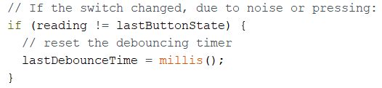
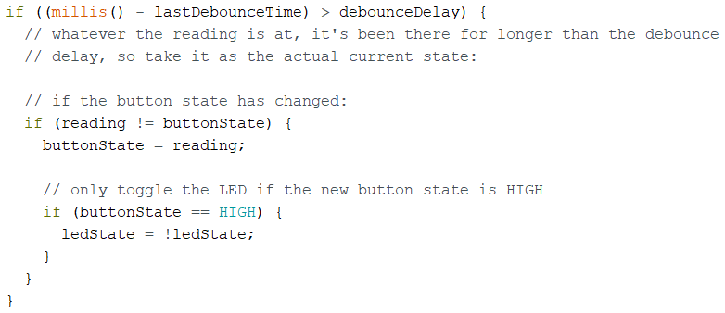
Changes in arduino IDE – loop()
Notes:
Button Reading:
The current state of the button (HIGH or LOW) is read from the GPIO pin specified by ‘buttonPin’
Debouncing Logic:
The code checks if the current button state (reading) is different from the last recorded state (lastButtonState).
If it is, it resets the debounce timer. Then, it checks if enough time (debounceDelay) has passed since the last state change
Button State Change Handling
If the button state has changed, it updates the buttonState variable. If the new state is HIGH (button pressed), it toggles the ledState. This ledState controls the state of the output pin.
Output Toggle Based on Button State
The ledState is then used to set the state of the output pin (output). This controls the connected device, such as an LED or a relay

Slide 27
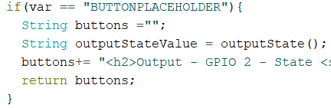
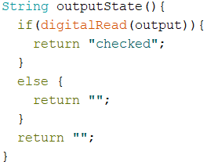
Changes in arduino IDE – functions
Notes:
The processor function is a callback function that gets called when processing placeholders in the HTML page served by the ESP8266.
The processor function takes a string var as a parameter, which represents a placeholder in the HTML page.
If the placeholder is "STATE," the function returns the current randomNumber. This placeholder is likely used to dynamically insert the random number into the HTML page.
If the placeholder is "BUTTONPLACEHOLDER," the function proceeds to generate HTML code for a button and its associated state.
HTML Generation for Button Placeholder:
A string buttons is initialized to store the HTML code for the button.
The outputState() function is called to determine the state of the output pin and whether the checkbox should be checked.
The HTML code for a switch with a checkbox is constructed. The onchange attribute is set to call the toggleCheckbox JavaScript function when the checkbox state changes.
The resulting HTML code is returned.
If the placeholder is neither "STATE" nor "BUTTONPLACEHOLDER," an empty string is returned.
Summary:
The processor function is responsible for generating HTML code based on the placeholders in the HTML page.
It dynamically inserts the current random number for the "STATE" placeholder and generates HTML code for a switch/button with the "BUTTONPLACEHOLDER."
The generated HTML is then used to update the web page served by the ESP8266.
We add a button placeholder inside the processor function, underneith the random number part:
The buttons variable to be returned:
<h2>Output - GPIO 2 - State <span id=\"outputState\"></span></h2><label class=\"switch\"><input type=\"checkbox\" onchange=\"toggleCheckbox(this)\" id=\"output\" " + outputStateValue + "><span class=\"slider\"></span></label>";

